Slide 1
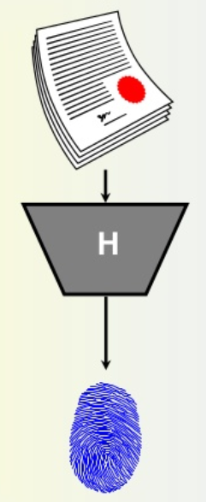
Cryptographic Hash and MAC

Slide 2
Outline
To introduce general ideas behind cryptographic hash functions
To discuss the Merkle-Damgard scheme as the basis for iterated hash functions
To distinguish between two categories of hash functions.
To discuss the structure of SHA-512.

Slide 3
Outline
❏ To define message integrity
❏ To define message authentication
❏ To define criteria for a cryptographic hash function
❏ To define the Random Oracle Model and its role in evaluating the security of cryptographic hash functions
❏ To distinguish between an MDC and a MAC
❏ To discuss some common MACs

Slide 4
Message Authentication Requirements
Disclosure
2. Traffic analysis
3. Masquerade
4. Content modification
5. Sequence modification
6. Timing modification
7. Source repudiation
8. Destination repudiation

Slide 5
Message Authentication Functions
Hash function: A function that maps a message of any length into a fixed length hash value, which serves as the authenticator
Message encryption: The ciphertext of the entire message serves as its authenticator
Message authentication code (MAC): A function of the message and a secret key that produces a fixed-length value that serves as the authenticator

Slide 6
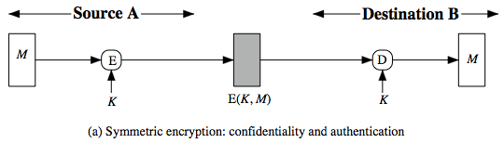
Symmetric Message Encryption
encryption can also provides authentication
if symmetric encryption is used then:
receiver know sender must have created it
since only sender and receiver now key used
know content cannot have been altered
if message has suitable structure, redundancy or a checksum to detect any changes
Notes:
Message encryption by itself can provide a measure of authentication. The analysis differs for symmetric and public-key encryption schemes.
If use symmetric encryption, If no other party knows the key, then confidentiality is provided. As well, symmetric encryption provides authentication as well as confidentiality, since only the other party can have encrypted a properly constructed message (Stallings Figure 12.1a). Here, the ciphertext of the entire message serves as its authenticator, on the basis that only those who know the appropriate keys could have validly encrypted the message. This is provided you can recognize a valid message (ie if the message has suitable structure such as redundancy or a checksum to detect any changes).

Slide 7
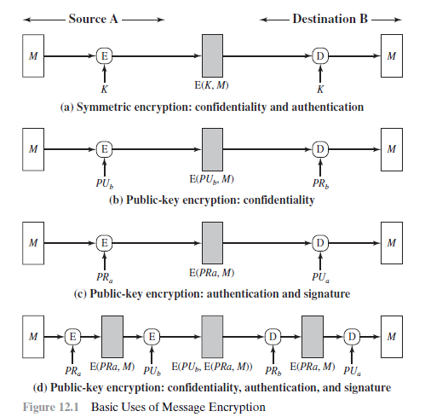
Message Encryption
Notes:
Message encryption by itself can provide a measure of authentication. The analysis differs for symmetric and public-key encryption schemes.
If use symmetric encryption, If no other party knows the key, then confidentiality is provided. As well, symmetric encryption provides authentication as well as confidentiality, since only the other party can have encrypted a properly constructed message (Stallings Figure 12.1a). Here, the ciphertext of the entire message serves as its authenticator, on the basis that only those who know the appropriate keys could have validly encrypted the message. This is provided you can recognize a valid message (ie if the message has suitable structure such as redundancy or a checksum to detect any changes).

Slide 8
Message Integrity
The cryptography systems that we have studied so far provide secrecy, or confidentiality, but not integrity. However, there are occasions where we may not even need secrecy but instead must have integrity.
Topics:
1 Document and Fingerprint
2 Message and Message Digest
3 Difference
4 Checking Integrity
5 Cryptographic Hash Function Criteria

Slide 9
Document and Fingerprint
One way to preserve the integrity of a document is through the use of a fingerprint. If Alice needs to be sure that the contents of her document will not be changed, she can put her fingerprint at the bottom of the document.

Slide 10
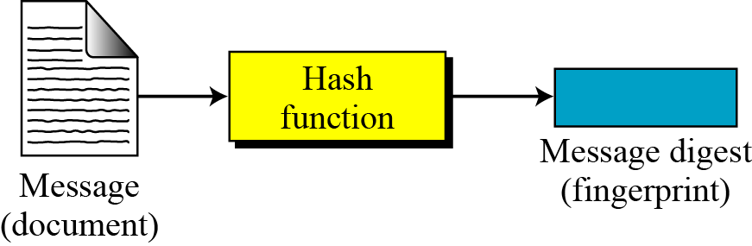
Message and Message Digest
The electronic equivalent of the document and fingerprint pair is the message and digest pair.
A hash function H accepts a variable-length block of data M as input and produces
a fixed-size hash value h = H(M).
Figure Message and digest

Slide 11
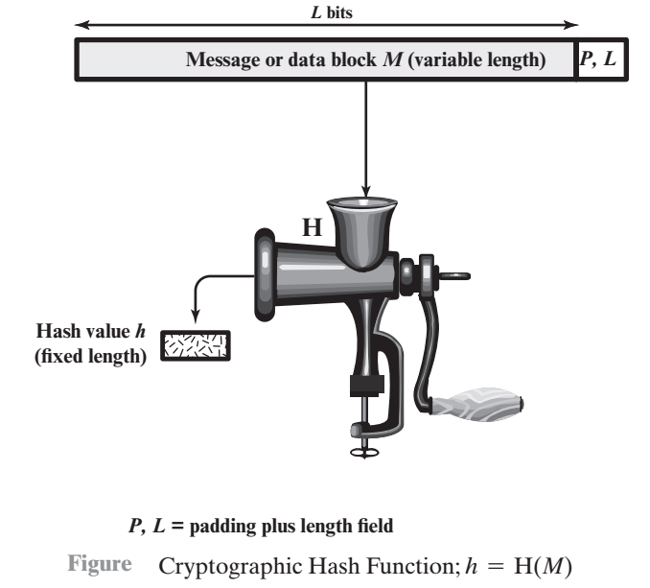
Cryptographic Hash Function

Slide 12
Application of Cryptographic Hash Function
Message Authentication: Message authentication is a mecha-nism or service used to verify the integrity of a message.
When a hash function is used to provide message authentication,
the hash function value is often referred to as a message digest.

Slide 13
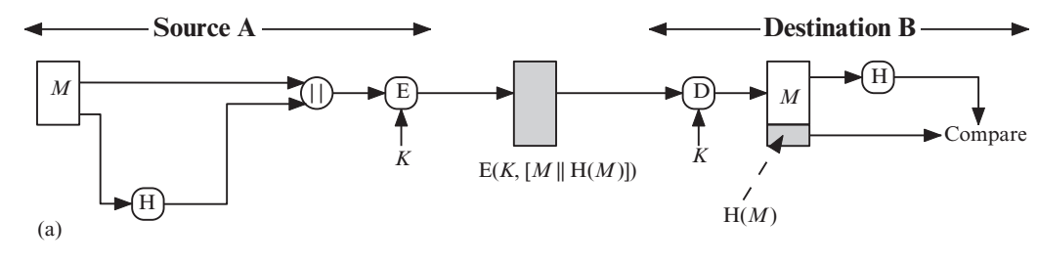
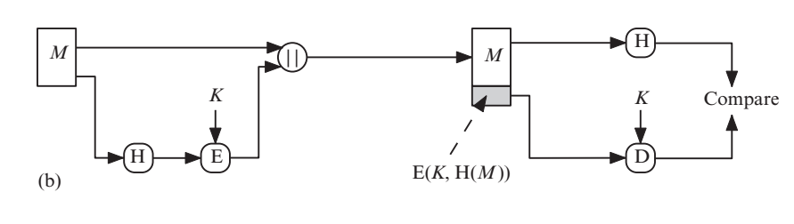
Application of Cryptographic Hash Function
Figures illustrates a variety of ways in which a hash code can be used to provide message authentication, as follows.

Slide 14
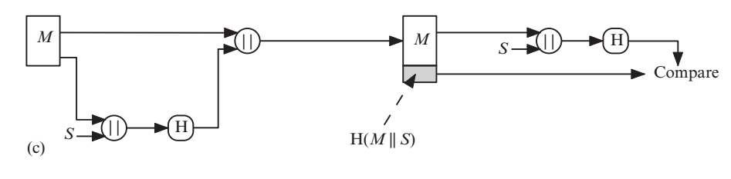
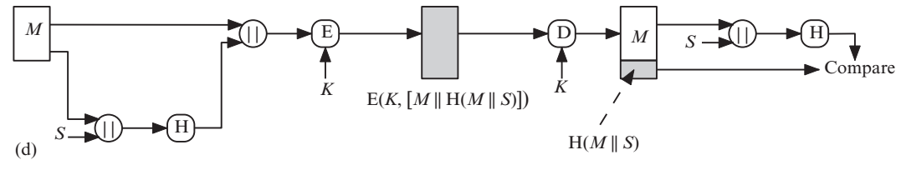
Application of Cryptographic Hash Function

Slide 15
MAC
More commonly, message authentication is achieved using a message authentication code (MAC), also known as a keyed hash function. Typically, MACs are used between two parties that share a secret key to authenticate information exchanged between those parties.

Slide 16
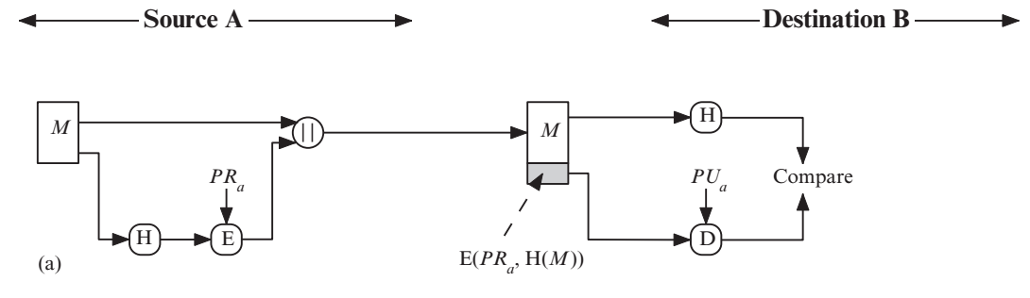
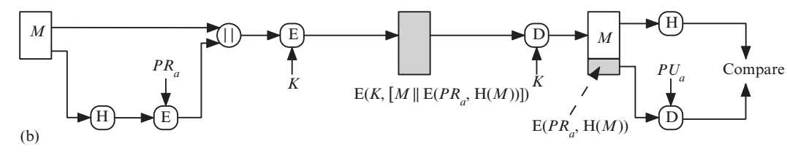
Digital Signatures
A digital signature is achieved throw:

Slide 17
Other Applications
One way password file:
Hash functions can be used for intrusion detection and virus detection.
can be used to construct a pseudorandom function (PRF) or a pseudorandom number generator (PRNG).

Slide 18
Difference
The two pairs (document / fingerprint) and (message / message digest) are similar, with some differences. The document and fingerprint are physically linked together. The message and message digest can be unlinked separately, and, most importantly, the message digest needs to be safe from change.
The message digest needs to be safe from change.

Slide 19
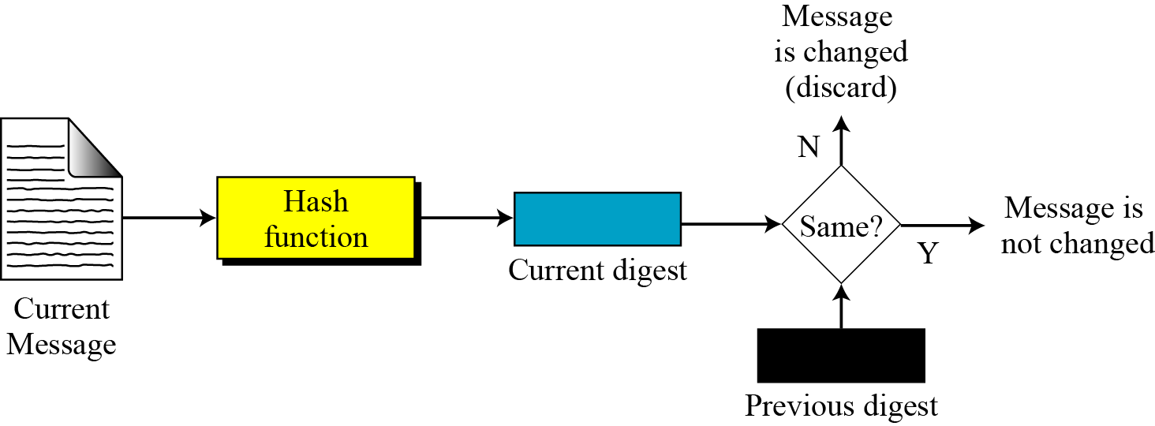
Checking Integrity
Figure Checking integrity

Slide 20
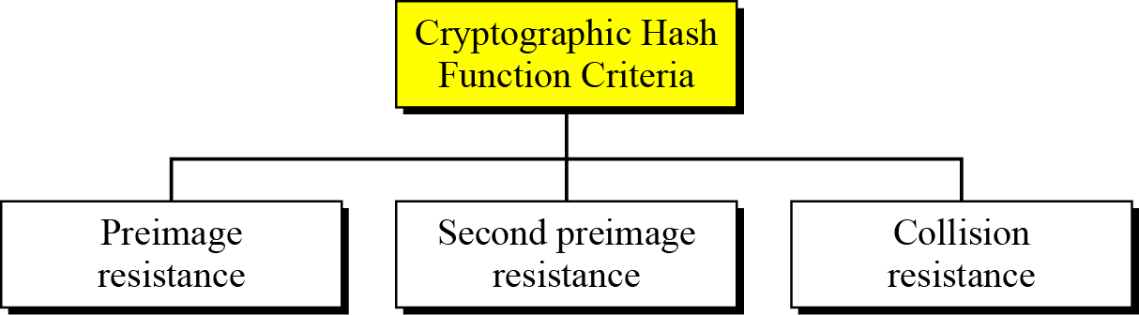
Cryptographic Hash Function Criteria
A cryptographic hash function must satisfy three criteria: preimage resistance, second preimage resistance, and collision resistance.
Figure Criteria of a cryptographic hash function

Slide 21
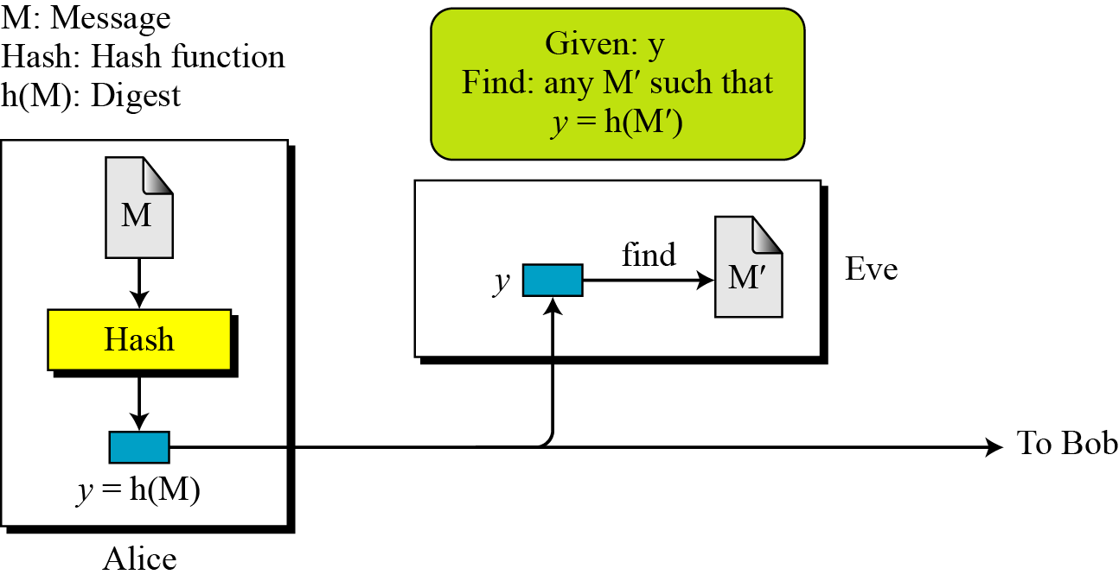
Preimage Resistance
Preimage Resistance
Figure Preimage

Slide 22
Preimage Resistance
Example
Can we use a conventional lossless compression method such as StuffIt as a cryptographic hash function?
Solution
We cannot. A lossless compression method creates a compressed message that is reversible.
Example
Can we use a checksum function as a cryptographic hash function?
Solution
We cannot. A checksum function is not preimage resistant, Eve may find several messages whose checksum matches the given one.

Slide 23
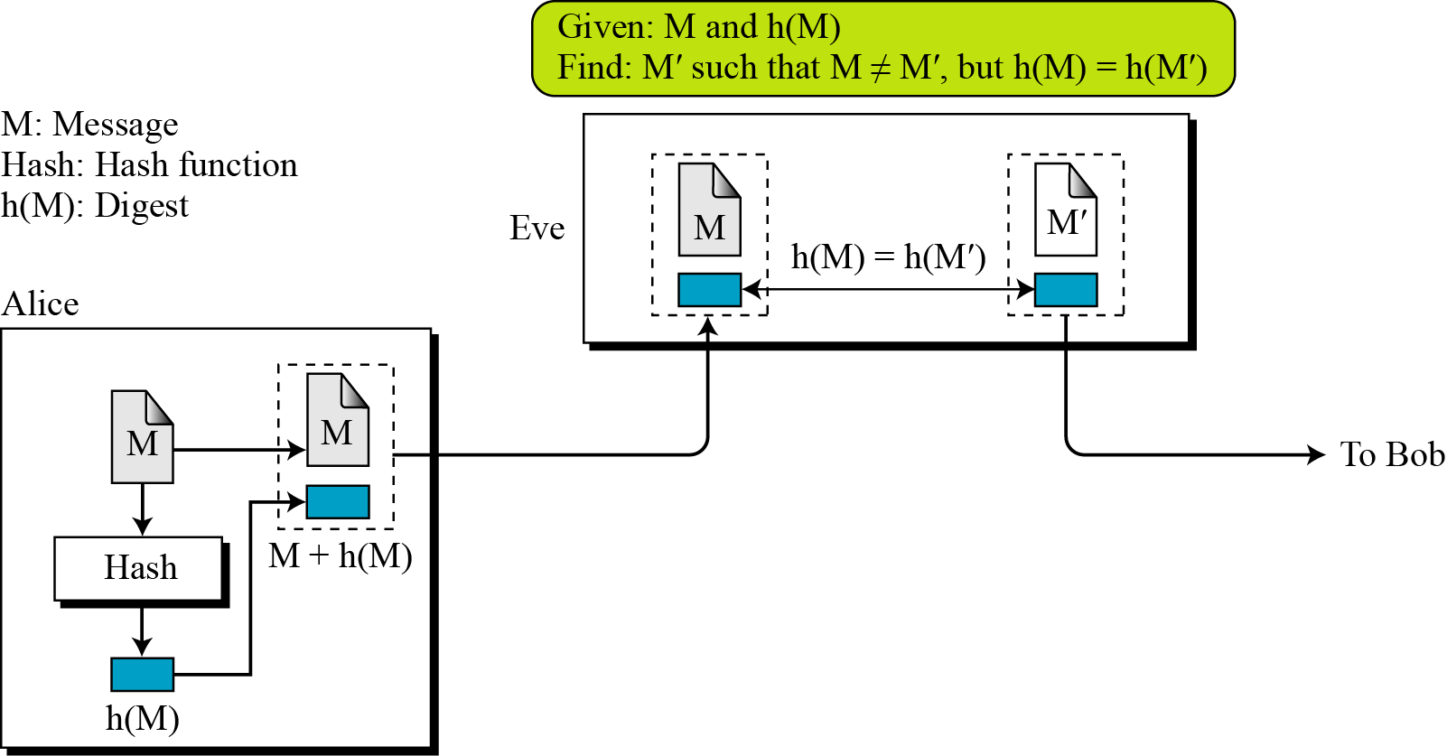
Second Preimage Resistance
Second Preimage Resistance
Figure Second preimage

Slide 24
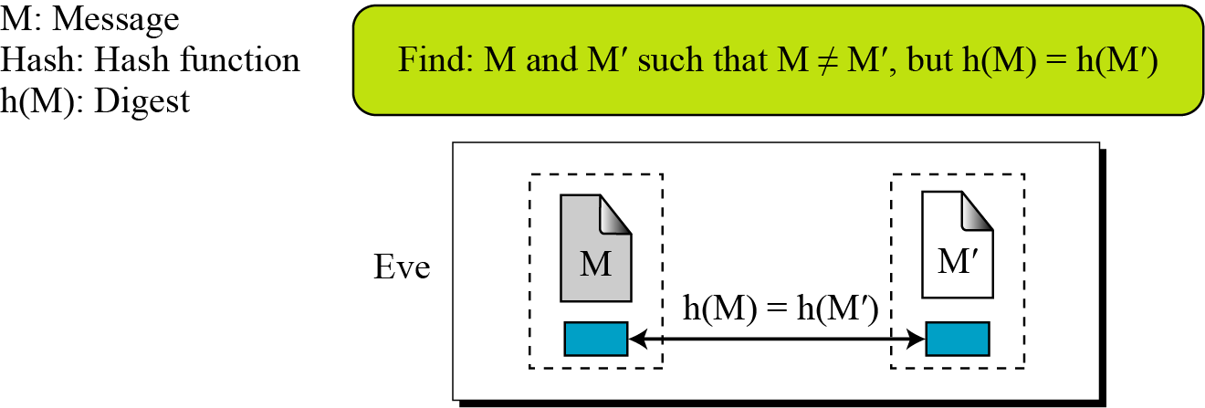
Collision Resistance
Collision Resistance
Figure Collision

Slide 25
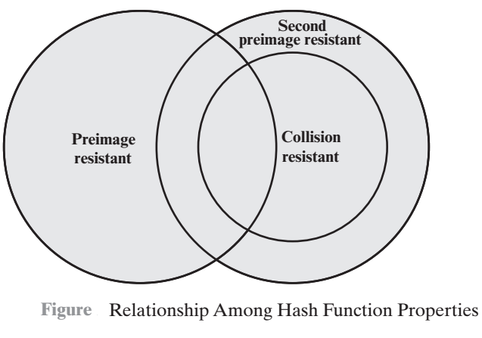
Relationship Among Hash Function Properties

Slide 26
Second Preimage Resistance
The Random Oracle Model, which was introduced in 1993 by Bellare and Rogaway, is an ideal mathematical model for a hash function.
Topics :
1 Pigeonhole Principle
2 Birthday Problems
3 Attacks on Random Oracle Model
4 Attacks on the Structure

Slide 27
Random Oracle Model
The Random Oracle Model, which was introduced in 1993 by Bellare and Rogaway, is an ideal mathematical model for a hash function.
Behaviour of Random Oracle Model:
For new message, creates random digest and stores both of them
If message is given, returns digest if exists
Digest for new message is independent from all previous digests

Slide 28
Pigeonhole Principal
If n pigeonholes are occupied by n + 1 pigeons, then at least one pigeonhole is occupied by two pigeons. The generalized version of the pigeonhole principle is that if n pigeonholes are occupied by kn + 1 pigeons, then at least one pigeonhole is occupied by k + 1 pigeons.
Behaviour of Random Oracle Model:

Slide 29
Pigeonhole Principal
Example
Assume that the messages in a hash function are 6 bits long and the digests are only 4 bits long. Then the possible number of digests (pigeonholes) is 24 = 16, and the possible number of messages (pigeons) is 26 = 64. This means n = 16 and kn + 1 = 64, so k is larger than 3. The conclusion is that at least one digest corresponds to four (i.e., k + 1) messages.

Slide 30
Uniformly distributed random variable with N possible values (o-N-1), what is the minimum number of instanes, k, such that it is likely that at least one instance is equal to a predefined value

Slide 31
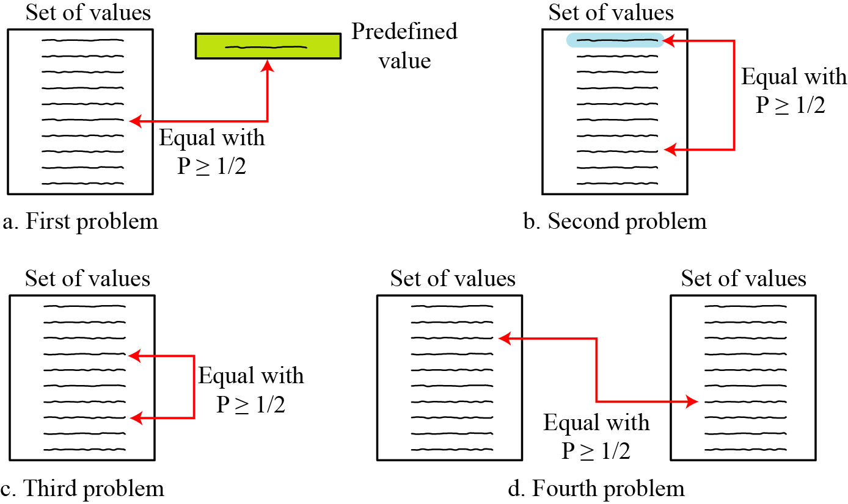
Birthday Problems: students in a classroom
Figure Four birthday problems are usually encountered in Probability courses
Birth date
Selected value
What Min number, k, list size
At least one matches
Any two values
any value
Birthday paradox
any value
Min number k values (same two sts)

Slide 32
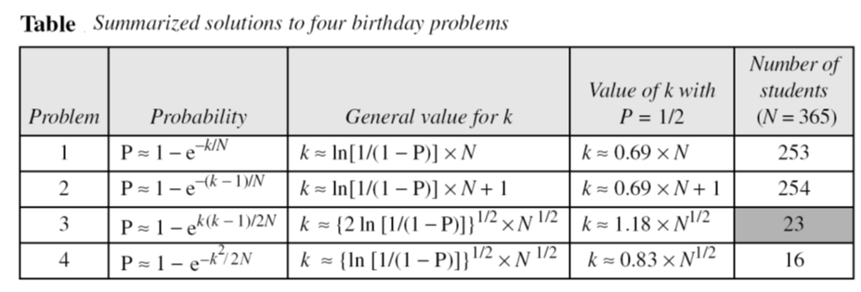
Birthday Problems
Summary of Solutions
Solutions to these problems are given in Appendix E for interested readers; The results are summarized in Table.

Slide 33
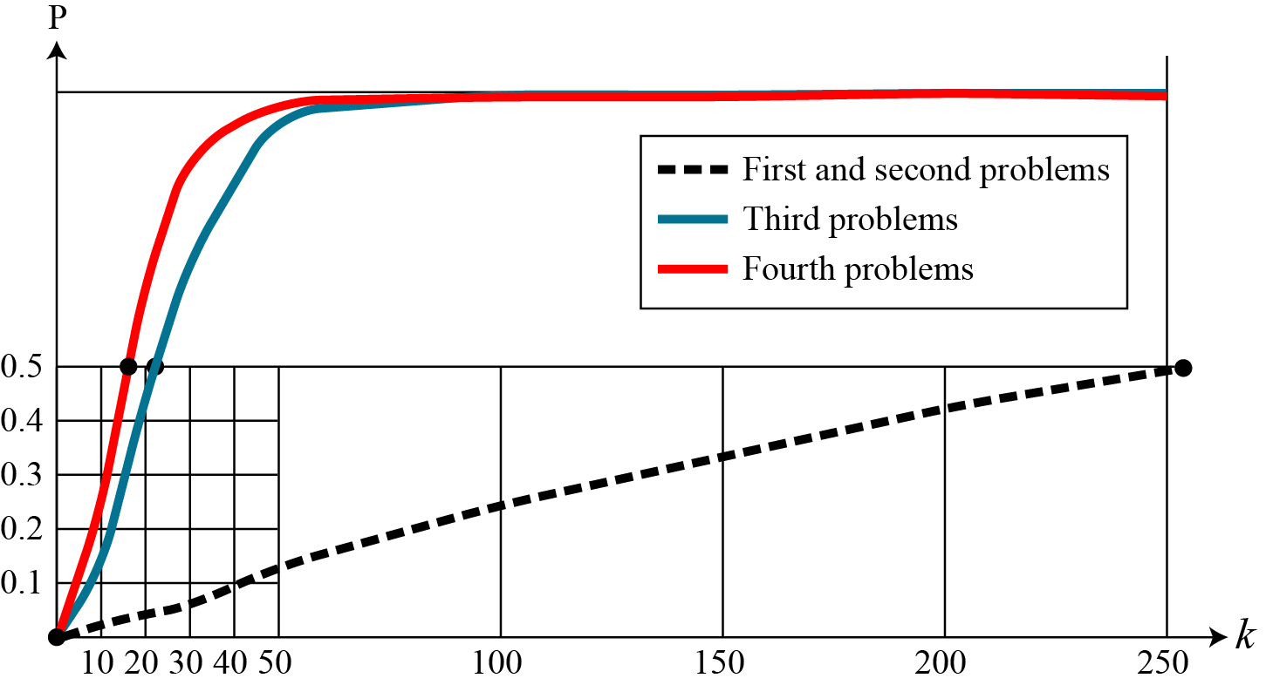
Comparison
Comparison
Figure Graph of four birthday problem
, probability
Preimage attack
Collision attack

Slide 34
Cryptographic hash function Types
A cryptographic hash function takes a message of arbitrary length and creates a message digest of fixed length. The ultimate goal in this lesson is to discuss the details of the two most promising cryptographic hash algorithms SHA-512 and Whirlpool.
1 Iterated Hash Function
2 Two Groups of Compression Functions

Slide 35
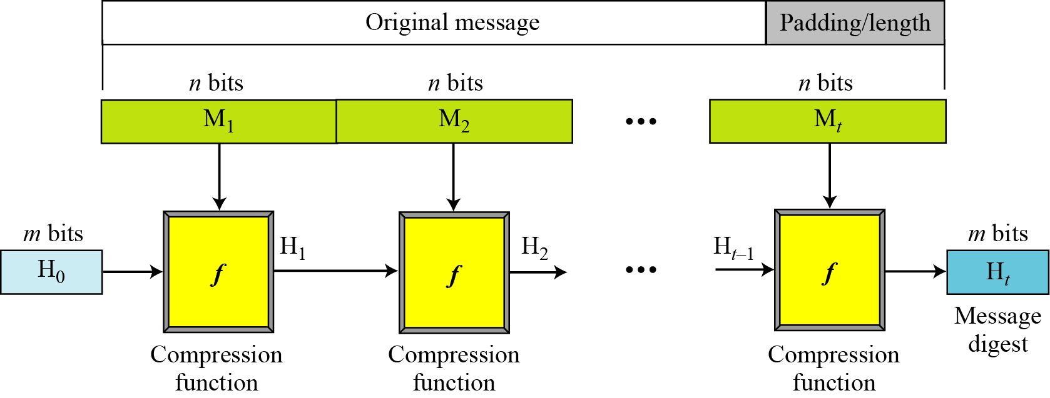
Iterated Hash Function
Merkle-Damgard Scheme : All cryptographic hash functions need to create a fixed-size digest out of a variable size message -> iteration
Initial Vector
Notes:
Before proceeding, we should mention several common misconceptions concerning
public-key encryption. One such misconception is that public-key encryption
is more secure from cryptanalysis than is symmetric encryption. In fact, the
security of any encryption scheme depends on the length of the key and the computational
work involved in breaking a cipher. There is nothing in principle about
either symmetric or public-key encryption that makes one superior to another from
the point of view of resisting cryptanalysis.
A second misconception is that public-key encryption is a general-purpose
technique that has made symmetric encryption obsolete. On the contrary, because
of the computational overhead of current public-key encryption schemes, there
seems no foreseeable likelihood that symmetric encryption will be abandoned. As
one of the inventors of public-key encryption has put it [DIFF88], “the restriction
of public-key cryptography to key management and signature applications is almost
universally accepted.”
Finally, there is a feeling that key distribution is trivial when using public-key
encryption, compared to the rather cumbersome handshaking involved with
key distribution centers for symmetric encryption. In fact, some form of protocol
is needed, generally involving a central agent, and the procedures involved are not
simpler nor any more efficient than those required for symmetric encryption (e.g.,
see analysis in [NEED78]).

Slide 36
Two Groups of Compression Functions
1. The compression function is made from scratch.
Message Digest (MD) (by Ron Rivest), SHA (by NIST
2. A symmetric-key block cipher serves as a compression function.
Whirlpool
Notes:
Before proceeding, we should mention several common misconceptions concerning
public-key encryption. One such misconception is that public-key encryption
is more secure from cryptanalysis than is symmetric encryption. In fact, the
security of any encryption scheme depends on the length of the key and the computational
work involved in breaking a cipher. There is nothing in principle about
either symmetric or public-key encryption that makes one superior to another from
the point of view of resisting cryptanalysis.
A second misconception is that public-key encryption is a general-purpose
technique that has made symmetric encryption obsolete. On the contrary, because
of the computational overhead of current public-key encryption schemes, there
seems no foreseeable likelihood that symmetric encryption will be abandoned. As
one of the inventors of public-key encryption has put it [DIFF88], “the restriction
of public-key cryptography to key management and signature applications is almost
universally accepted.”
Finally, there is a feeling that key distribution is trivial when using public-key
encryption, compared to the rather cumbersome handshaking involved with
key distribution centers for symmetric encryption. In fact, some form of protocol
is needed, generally involving a central agent, and the procedures involved are not
simpler nor any more efficient than those required for symmetric encryption (e.g.,
see analysis in [NEED78]).

Slide 37
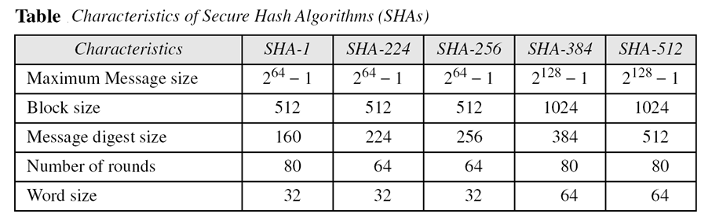
Two Groups of Compression Functions
Notes:
Before proceeding, we should mention several common misconceptions concerning
public-key encryption. One such misconception is that public-key encryption
is more secure from cryptanalysis than is symmetric encryption. In fact, the
security of any encryption scheme depends on the length of the key and the computational
work involved in breaking a cipher. There is nothing in principle about
either symmetric or public-key encryption that makes one superior to another from
the point of view of resisting cryptanalysis.
A second misconception is that public-key encryption is a general-purpose
technique that has made symmetric encryption obsolete. On the contrary, because
of the computational overhead of current public-key encryption schemes, there
seems no foreseeable likelihood that symmetric encryption will be abandoned. As
one of the inventors of public-key encryption has put it [DIFF88], “the restriction
of public-key cryptography to key management and signature applications is almost
universally accepted.”
Finally, there is a feeling that key distribution is trivial when using public-key
encryption, compared to the rather cumbersome handshaking involved with
key distribution centers for symmetric encryption. In fact, some form of protocol
is needed, generally involving a central agent, and the procedures involved are not
simpler nor any more efficient than those required for symmetric encryption (e.g.,
see analysis in [NEED78]).

Slide 38
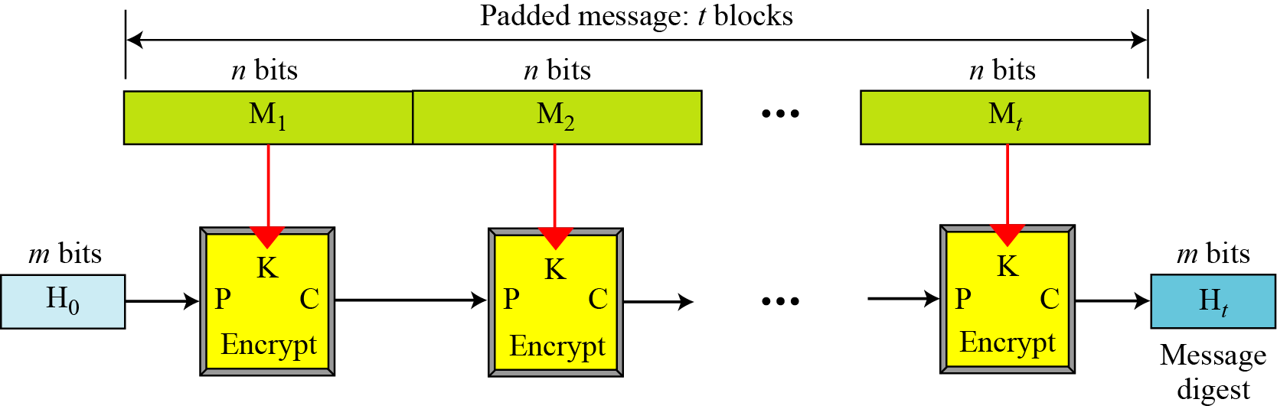
Hash Functions Based on Block Ciphers
Rabin Scheme (based on M-D scheme) uses any cipher as compression function
Figure Rabin scheme
vulnerable to meet-in-the-middle attack
Notes:
Before proceeding, we should mention several common misconceptions concerning
public-key encryption. One such misconception is that public-key encryption
is more secure from cryptanalysis than is symmetric encryption. In fact, the
security of any encryption scheme depends on the length of the key and the computational
work involved in breaking a cipher. There is nothing in principle about
either symmetric or public-key encryption that makes one superior to another from
the point of view of resisting cryptanalysis.
A second misconception is that public-key encryption is a general-purpose
technique that has made symmetric encryption obsolete. On the contrary, because
of the computational overhead of current public-key encryption schemes, there
seems no foreseeable likelihood that symmetric encryption will be abandoned. As
one of the inventors of public-key encryption has put it [DIFF88], “the restriction
of public-key cryptography to key management and signature applications is almost
universally accepted.”
Finally, there is a feeling that key distribution is trivial when using public-key
encryption, compared to the rather cumbersome handshaking involved with
key distribution centers for symmetric encryption. In fact, some form of protocol
is needed, generally involving a central agent, and the procedures involved are not
simpler nor any more efficient than those required for symmetric encryption (e.g.,
see analysis in [NEED78]).

Slide 39
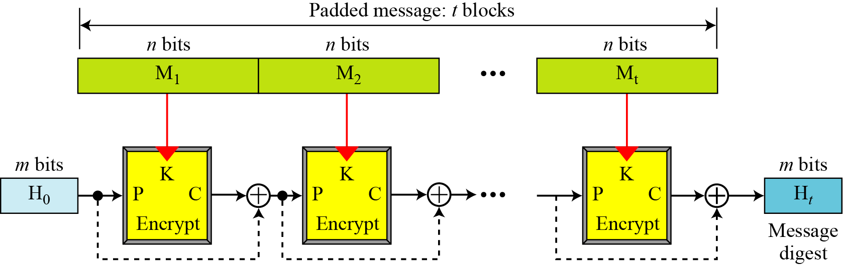
Hash Functions Based on Block Ciphers
Davies-Meyer Scheme
Figure Davies-Meyer scheme
To protect from meet-in-the-middle attack
Notes:
Before proceeding, we should mention several common misconceptions concerning
public-key encryption. One such misconception is that public-key encryption
is more secure from cryptanalysis than is symmetric encryption. In fact, the
security of any encryption scheme depends on the length of the key and the computational
work involved in breaking a cipher. There is nothing in principle about
either symmetric or public-key encryption that makes one superior to another from
the point of view of resisting cryptanalysis.
A second misconception is that public-key encryption is a general-purpose
technique that has made symmetric encryption obsolete. On the contrary, because
of the computational overhead of current public-key encryption schemes, there
seems no foreseeable likelihood that symmetric encryption will be abandoned. As
one of the inventors of public-key encryption has put it [DIFF88], “the restriction
of public-key cryptography to key management and signature applications is almost
universally accepted.”
Finally, there is a feeling that key distribution is trivial when using public-key
encryption, compared to the rather cumbersome handshaking involved with
key distribution centers for symmetric encryption. In fact, some form of protocol
is needed, generally involving a central agent, and the procedures involved are not
simpler nor any more efficient than those required for symmetric encryption (e.g.,
see analysis in [NEED78]).

